Slide 1
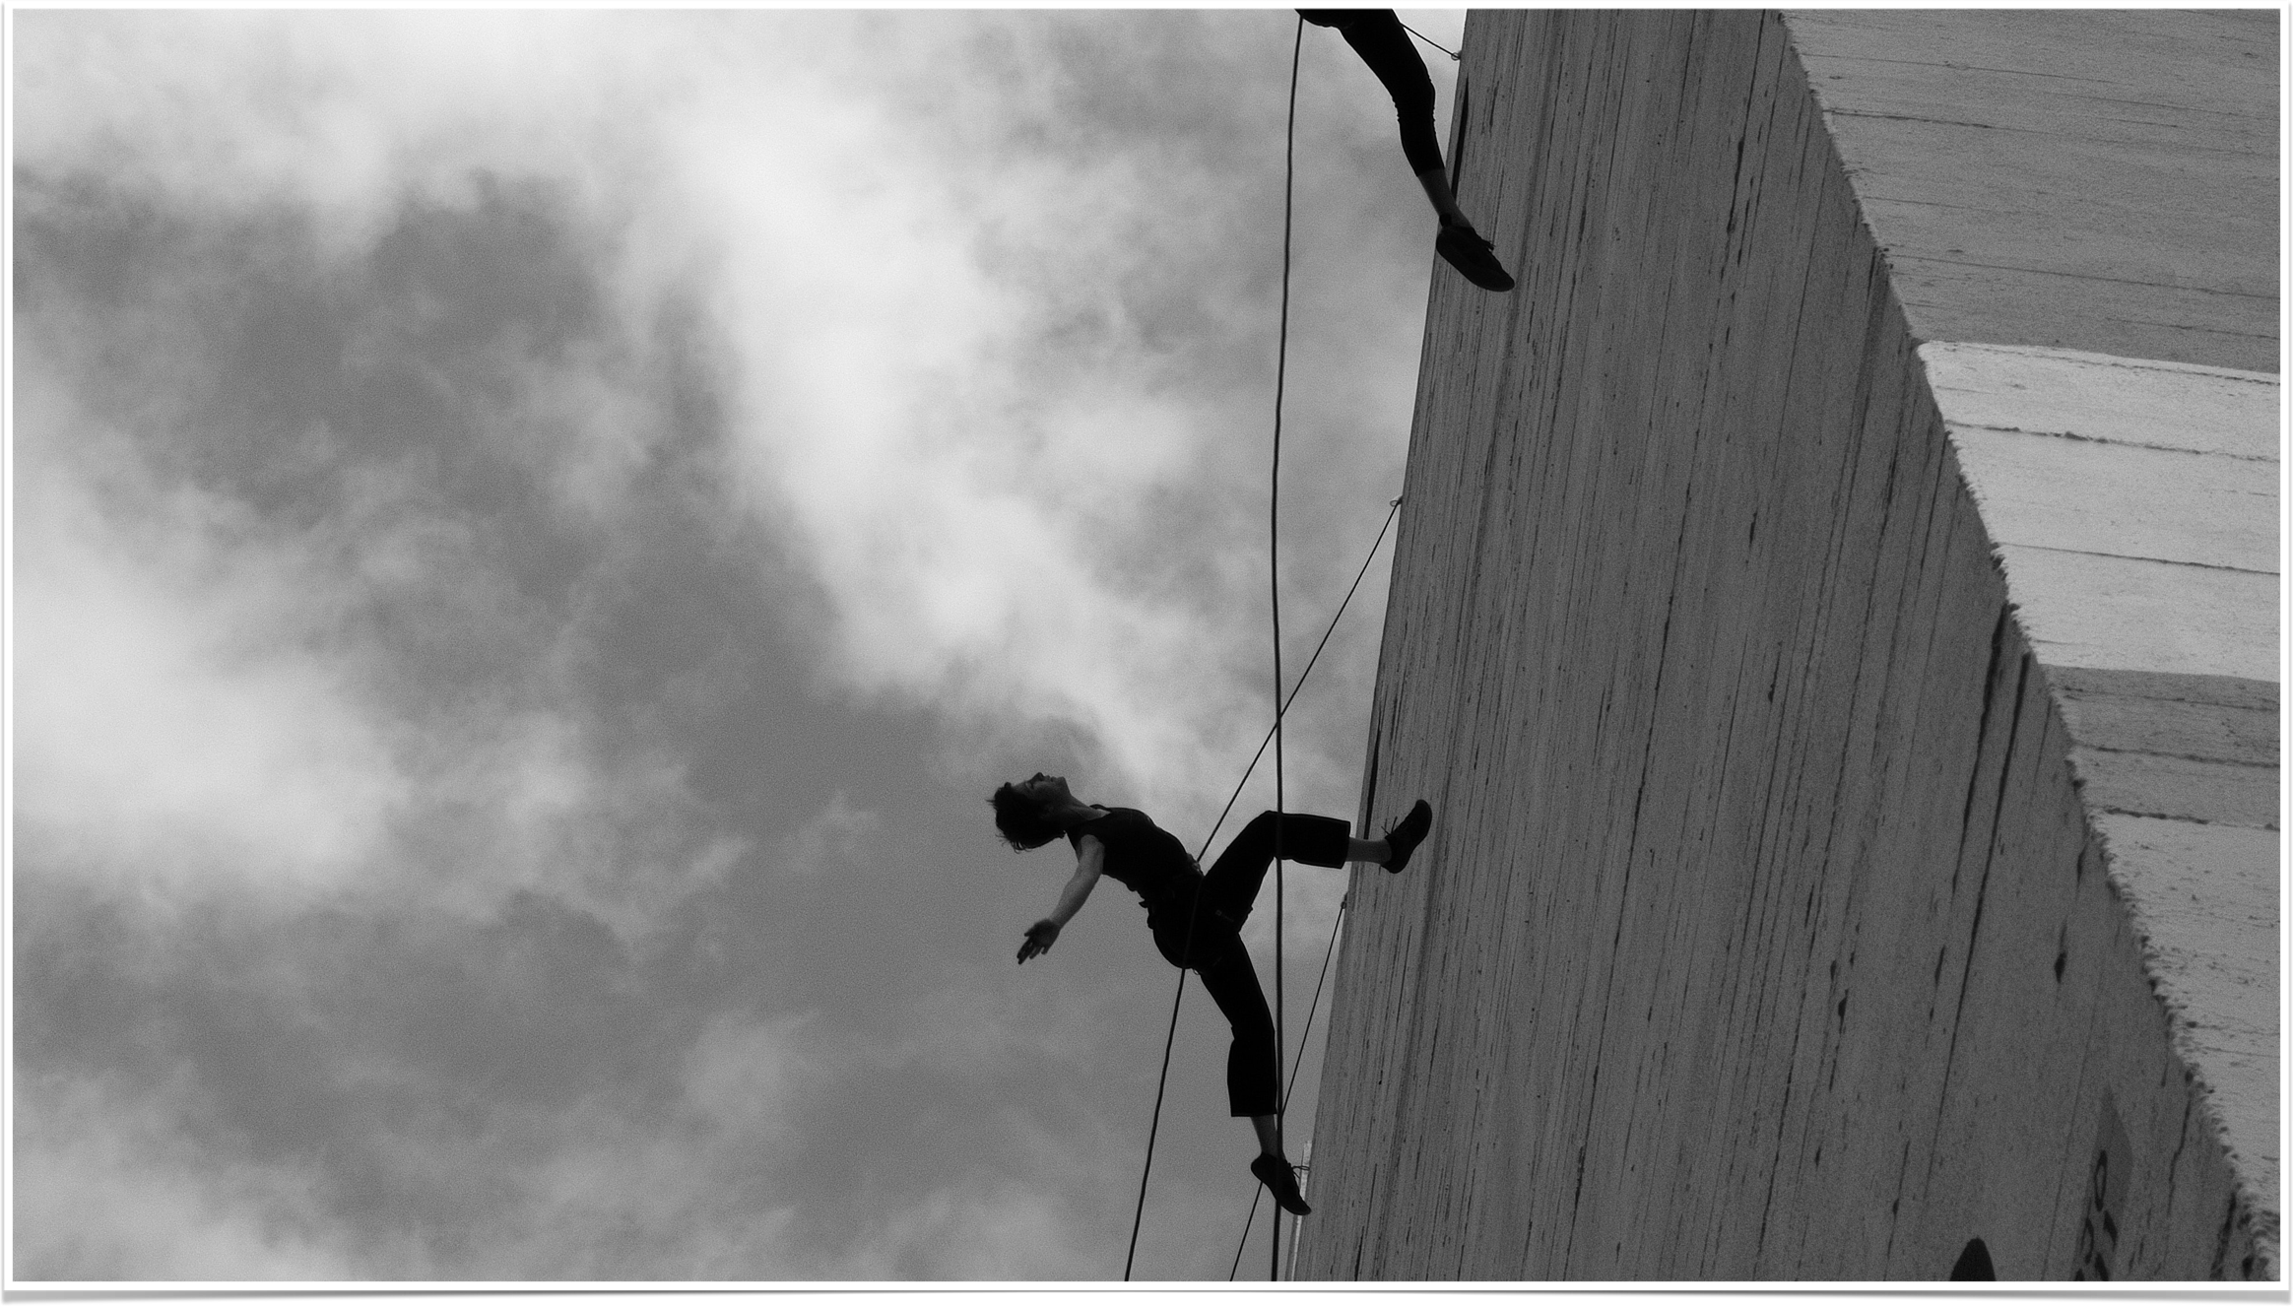
The Dance of Critical Thinking and Creative Writing

Slide 2
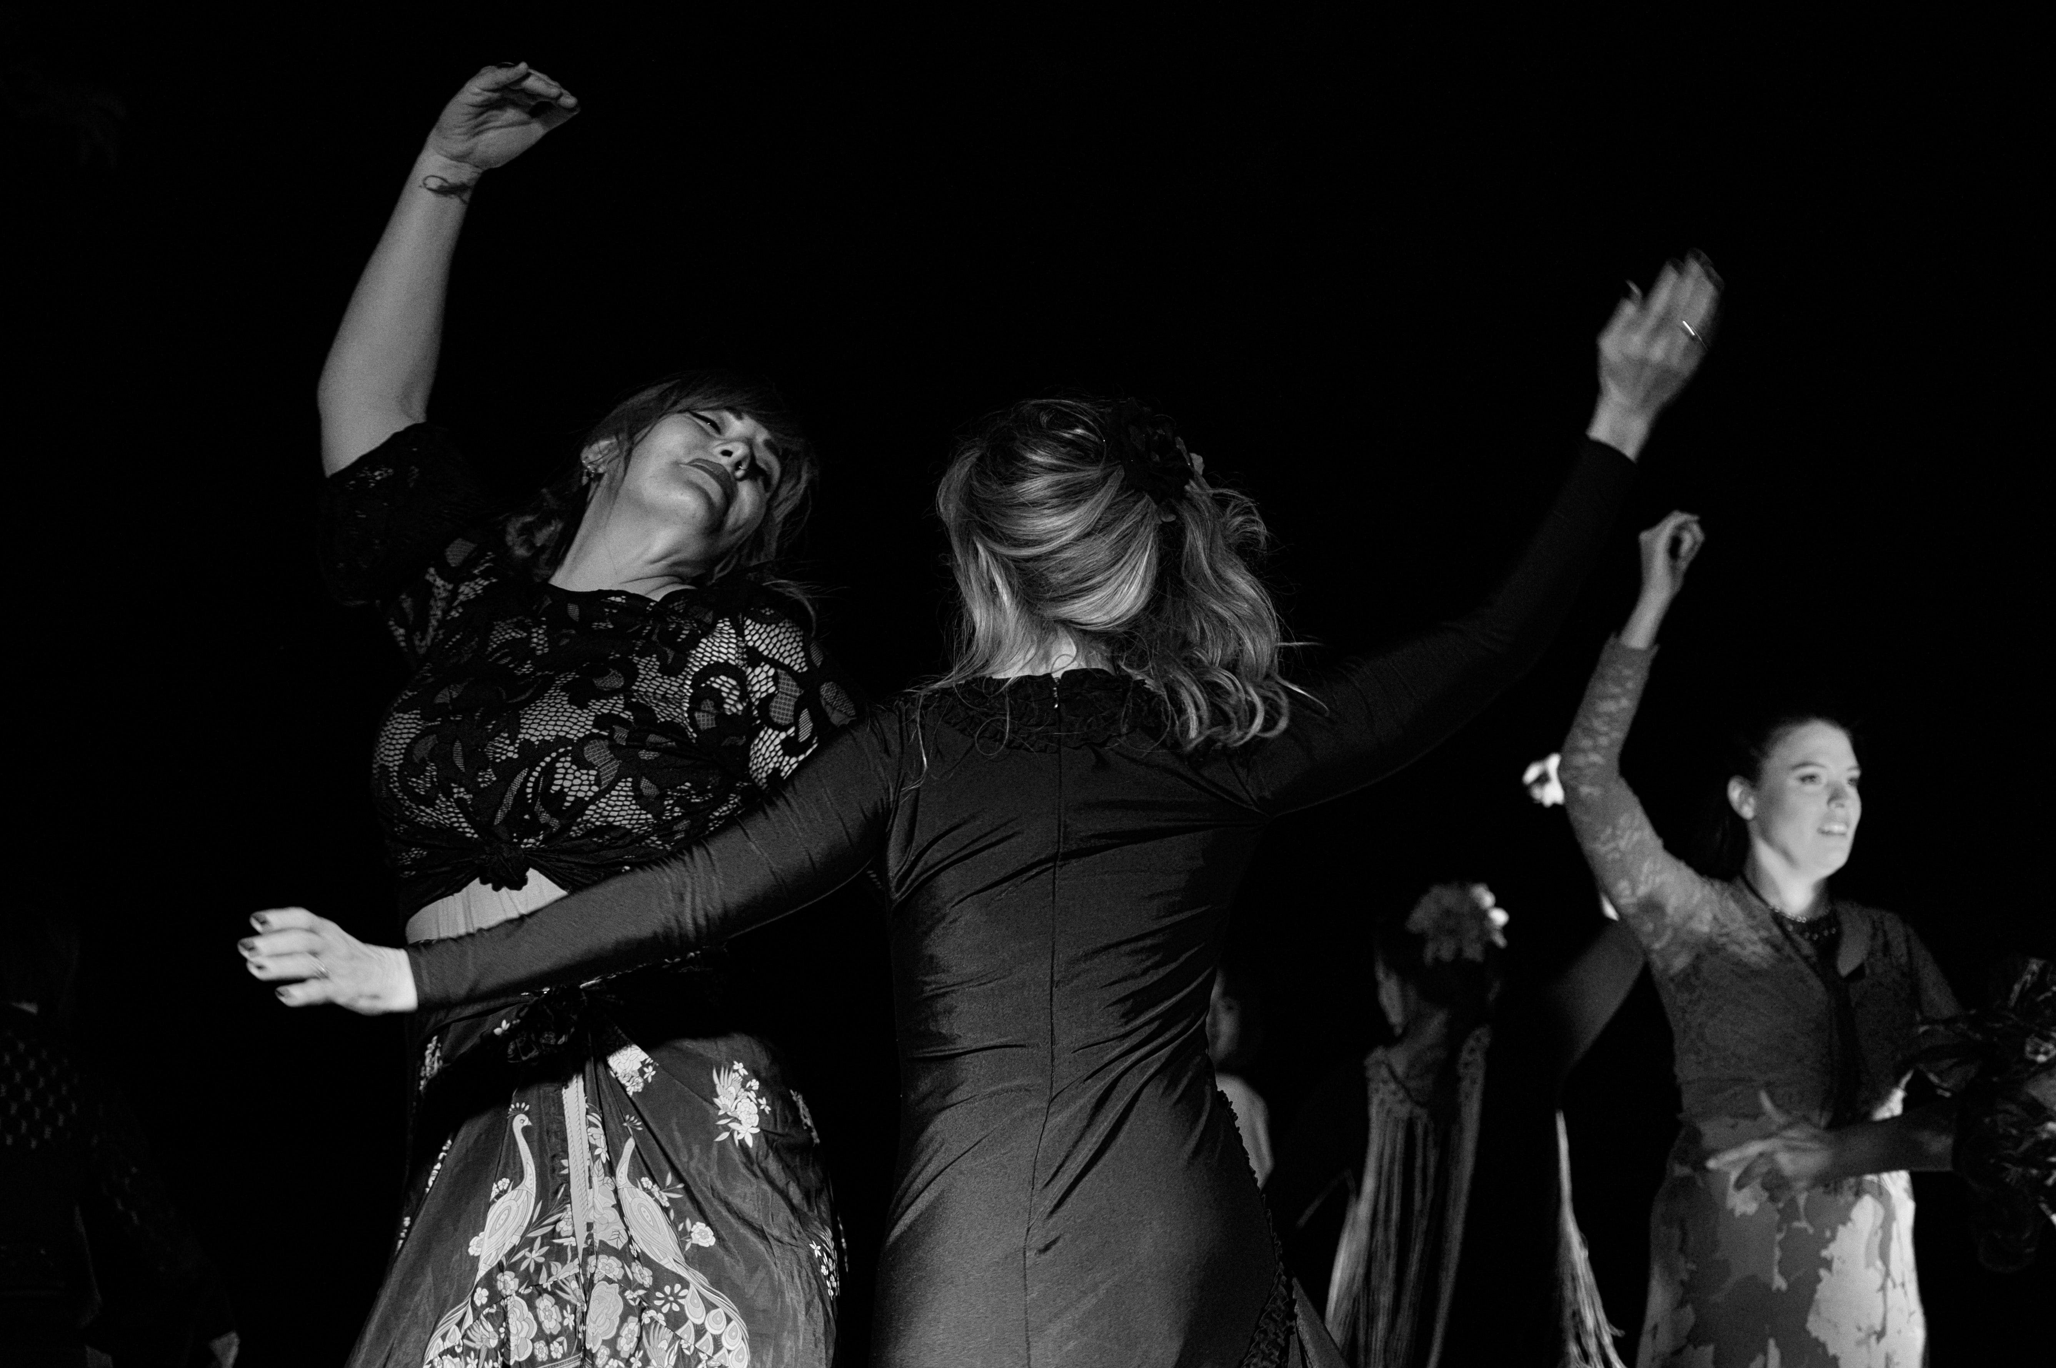
‘How can we know the dancer from the dance?’

Slide 3
Writing is both personal and worldly. So I position my creative practice through a critical lens which makes me feel my writing speaks in, and of, the world. This means I consider my writing practice as positioning me as both the dancer and the dance.

Slide 4
Critical thinking that gives a deeper understanding of reality, and at the same time dares to imagine other potential realities. I think that the creative imagination is essential to critical thought because it allows the development of alternative visions and methodologies, which in turn can foster personal and social transformations.

Slide 5
Students comment on ‘the strength of critically and imaginatively articulating experience in creating new storyworlds.’

Slide 6
We use the creative writing workshop as a collaborative teaching method for all our teaching. This is because the writing workshop is primarily about works in progress. The creative writing workshop values learning as a state of becoming.

Slide 7
Using the Creative Writing Workshop to teach critical perspectives on motherhood to emotional and imaginative approaches to the theme. Application of and inspiration from posthumanist concepts (tentacularity, symbiosis, etc.) which open up imaginative ways of combining autobiographical writing, fictional representations, and critical explorations of motherhood and mothering.

Slide 8
The trajectory their writing takes will be both critical and creative. Regardless of the ways in which they write, their concern is to articulate new thoughts in language. The group’s shared key words becomes a centre of gravity for the thinking and writing that occurs.

Slide 9
In the Critical Workshop, the students’ concern to ‘articulate new thoughts in language’ in their creative writing exercises translates into the exciting and challenging task of identifying a ‘gap in the scholarship’ that they will try to address with their original approach to mothers, mothering and motherhood.

Slide 10
When the students had finished the writing exercises, we shared our words and then they set about creating motherboards using different mediums.

Slide 11
Definition of motherboard: a printed circuit board containing the principal components of a computer or other device, with connectors for other circuit boards to be slotted into. (OED) The mother board connects communication, power and memory.
Definition of mother: Impossible to define as the term is endlessly open to interpretation. The word is connected to human, animal and plant life, to the environment, to nature and to industry.

Slide 12
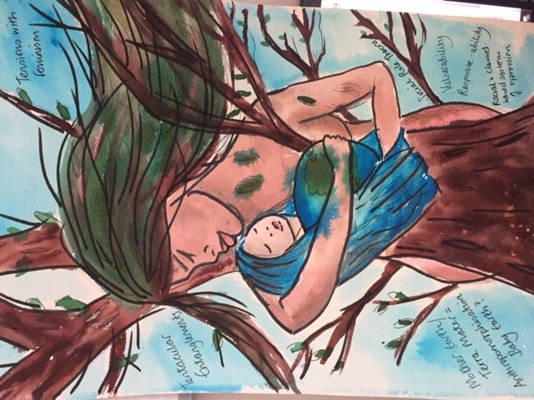

Slide 13
